Slide 1
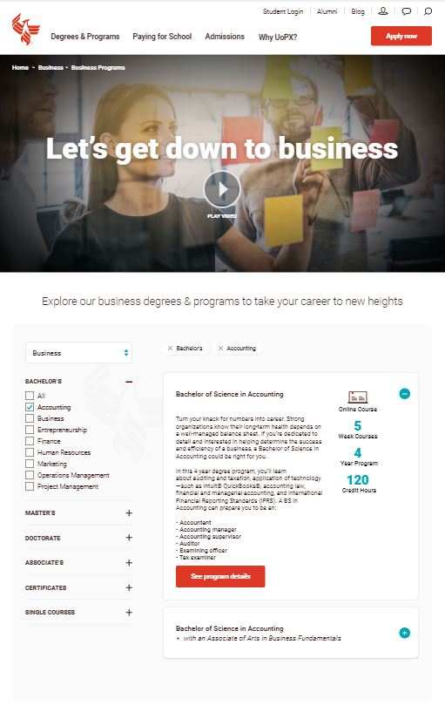
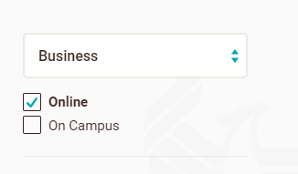
Notes:
Single component, single page
Dynamic urls
Utilize the same FOS/AOI/Program mapping as the program finder to determine programs to display
Show parent programs first (alpha order if more than one, child programs following the parent programs.
Swap out image/FOS text if user changes FOS
Hide custom AOI copy if a user begins modifying filters
Breadcrumbs should not be part of this component. Please exclude this
Must support image or video authorable for each FOS. Default to image if no video.
Text should be displayed on top of image or video
FOS authorable content for each FOS
85258
Display already selected filter options with option to remove a selected option
Custom AOI text
AOI text to be shown only if an AOI filter was passed in on initial load
Expanded state
Modality should pull from PLCT for online/campus or both
This should reference the component on new program page for course length
This should reference the component on new program page for Approx Length
This should reference the component on new program page for credit hours
These currently reside on new program pages on the outcomes tab. We should think of possible options to get this data, but is lower priority than the rest of the component data
CTA button to See program details. Drives to program page.
Collapsed state
Program marketing text should come from the PLCT program attributes programDescriptionShort
Program name should come from the PLCT program attributes programAltName
Degree/AOI’s – multiple can be selected at once if desired. Exclude single courses for MVP as we do not have the FOS/AOI mapping for those.
FOS dropdown should show the passed through FOS , but have the ability for users to change the FOS as desired which then updates the image/video and also custom FOS text.
Zipcode should use our existing geoip functionality as it does for program finder. Users can filter by modality.

